Slide 1
Cover Page:Workshop#2 Storyboard Assignment.
Student Name:
Student ID:
Course Name and Section
Professor Wendy Woof-Severn
Submission Date: Tuesday July 28th,2020 to BB by 11:59 p.m.

Slide 2
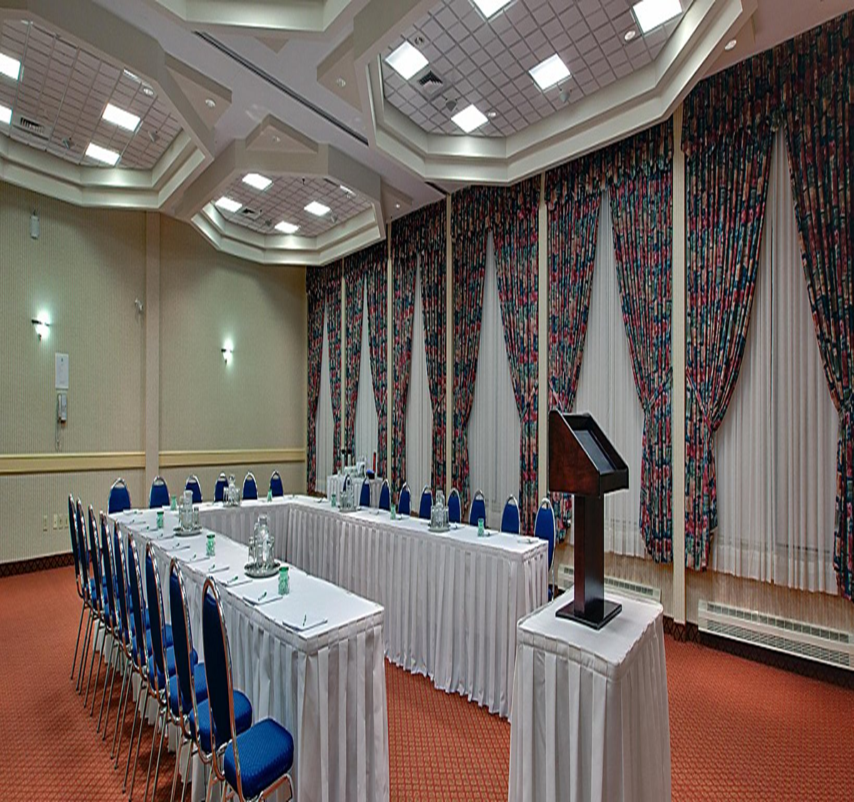
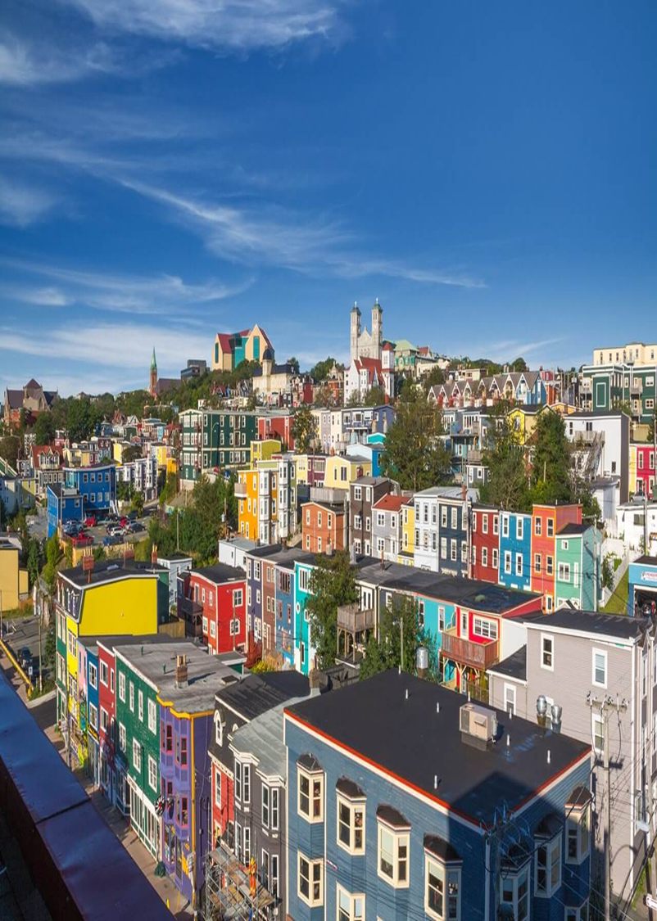
Hotel or Convention Centre Meeting Room Set Up
(Shrimpton,1980)

Slide 3

Hospitality Newfoundland and Labrador’s Annual Conference and Tradeshow is the largest tourist stakeholder’s gathering in the province.
This facilitiesfrom sectors both rural and urban centers: including facility managers and operators(Moore,2007).

Slide 4
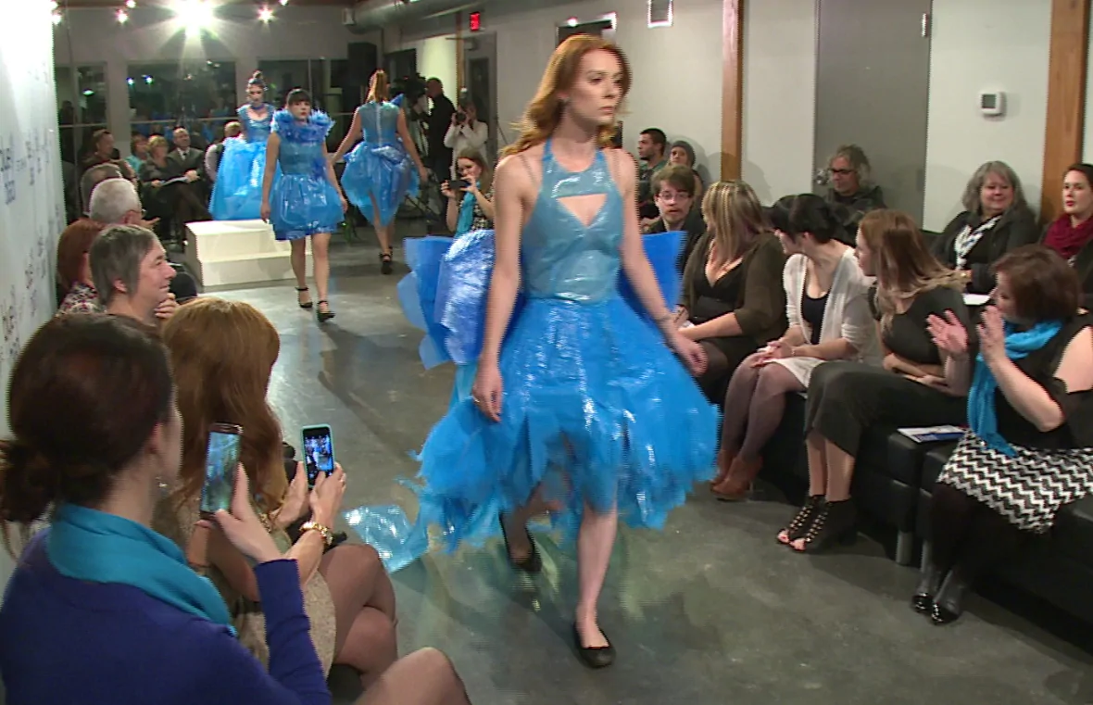
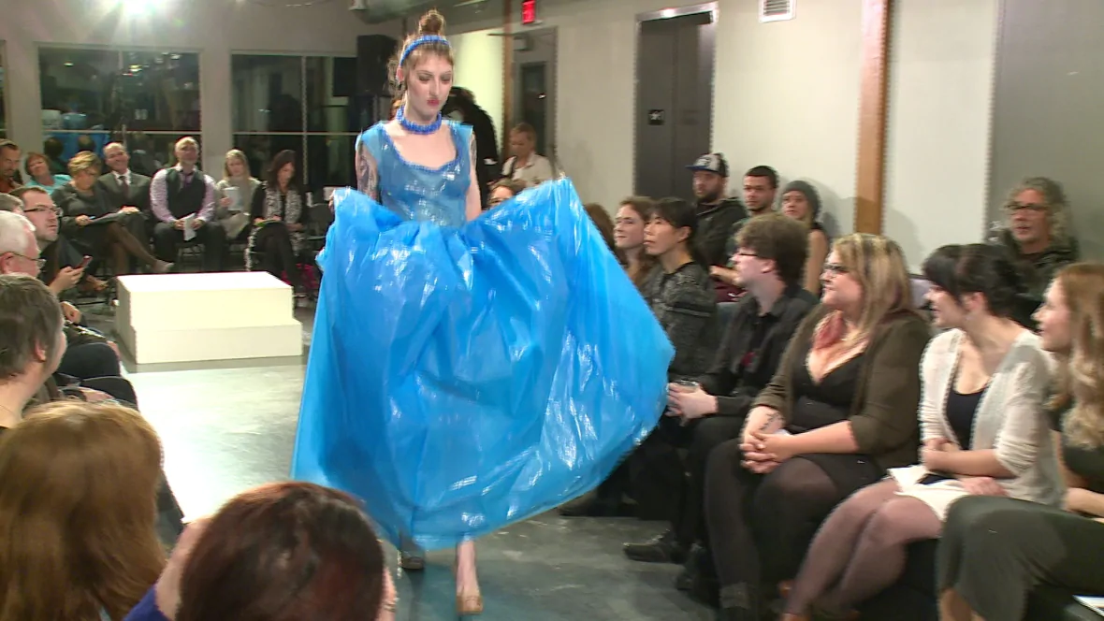
Blue recycling bags are seldom seen on runways, but the City of St. John's wants more people using its curbside recycling program so it's turning to fashion to get the message out(Temple,2008).
The Blue is the new Black campaign launched Wednesday night, with models showing off dresses made entirely out of blue plastic recycling bags.

Slide 5
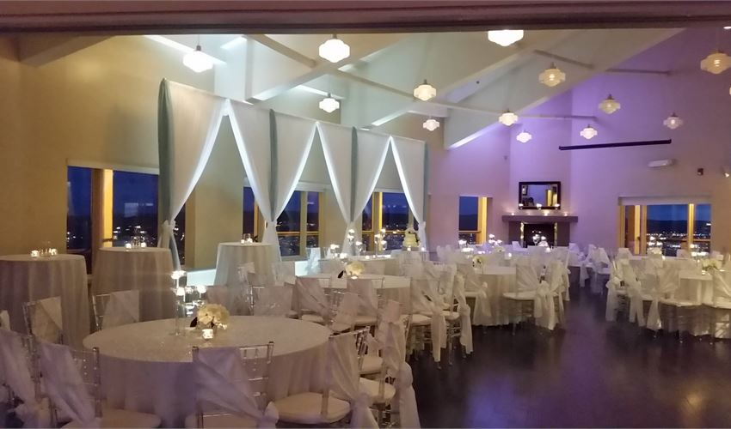
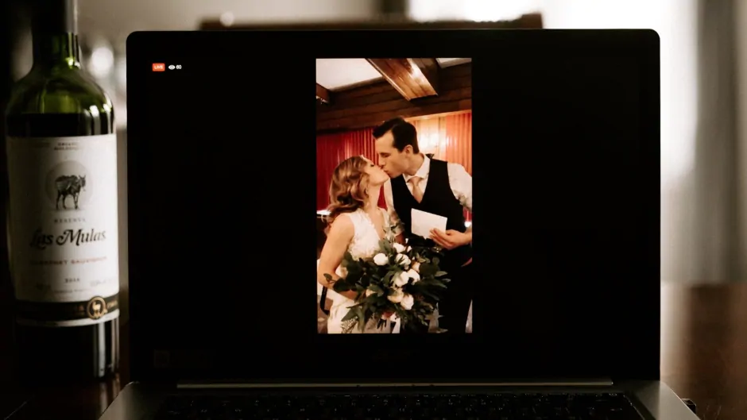
From the Initial planning stages to the moment you take the first step down the aisle (Coombs-Thorne,2010).
The room with its vaulted ceilings and abundance of natural lighting and panoramic views of the city is perfect setting for your special day .
Not even a global health crisis could cancel their dream wedding in Central America.

Slide 6


You’re likely to find something interesting at Newfoundland Times, whether you’re planning a visit to Newfoundland or already live there(High,2010). Did you know there are businesses who like to gift their customers with FREE things on their birthday? If you live in Newfoundland, there are various offerings complied for you. Grab your ID, hit the road, and enjoy your birthday without cooking or doing the dishes once!

Slide 7
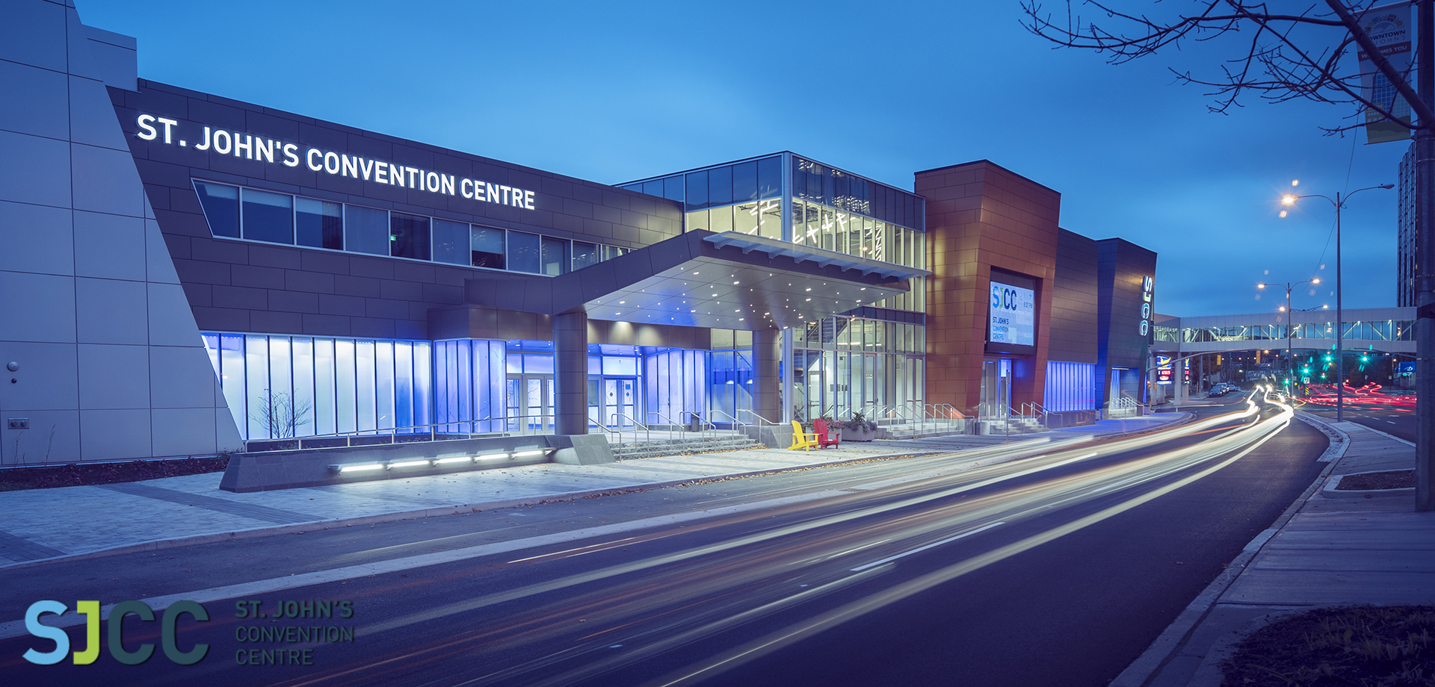
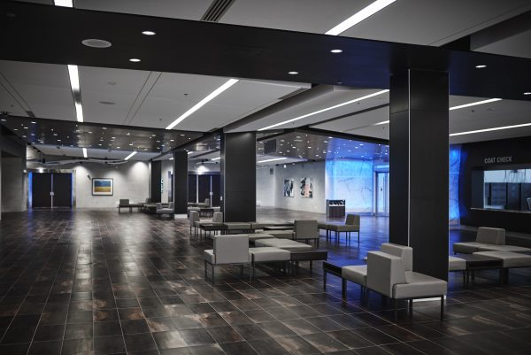
The St. John’s Convention Centre (SJCC) is Newfoundland and Labrador’s largest and most innovative conference facility.
It has 47,000 sq ft of divisible meeting room space for both small and huge events( Lih ,2017).
SJCC’s state-of-the-art technical services, professional staff, and modern facilities create opportunities to host flawless, unforgettable events.
The Convention Centre is located in the North America’s oldest city heart, which has rich culture, history, the most friendliest people and charm.

Slide 8
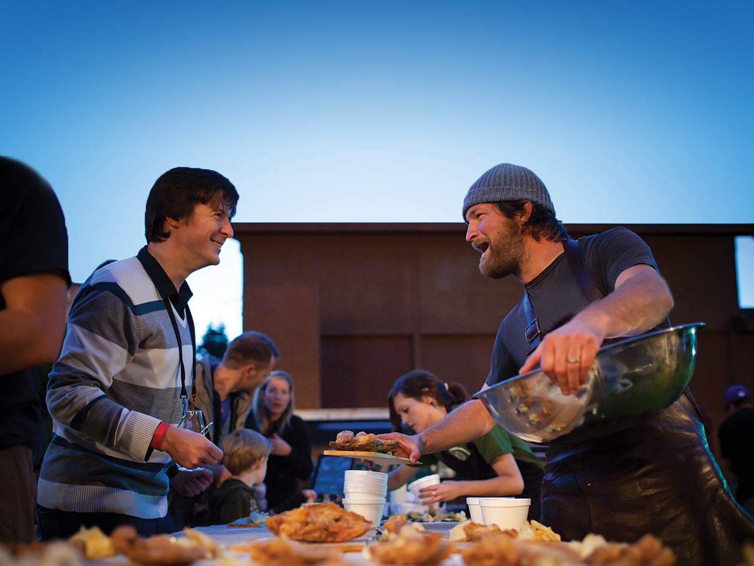
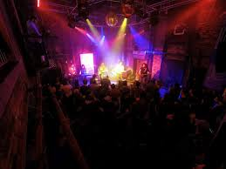
Factory-Performance and Event Venue- St. John’s Newfoundland(Koh,1990).

Slide 9
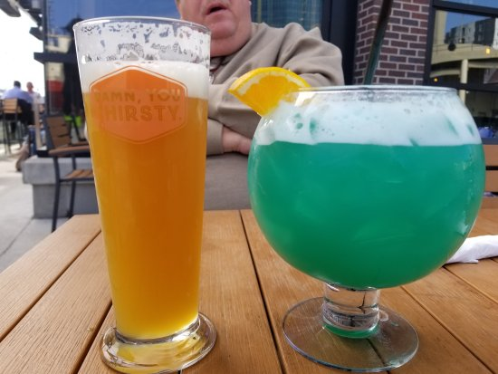
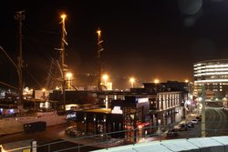
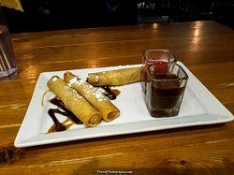
Jack Astor's Bar & Grill
Details
American, Bar, Canadian: SPECIAL DIETS
Vegetarian Friendly, Gluten Free Options( Mah ,2019.) MEALS: Lunch, Dinner, Brunch, Late Night

Slide 10
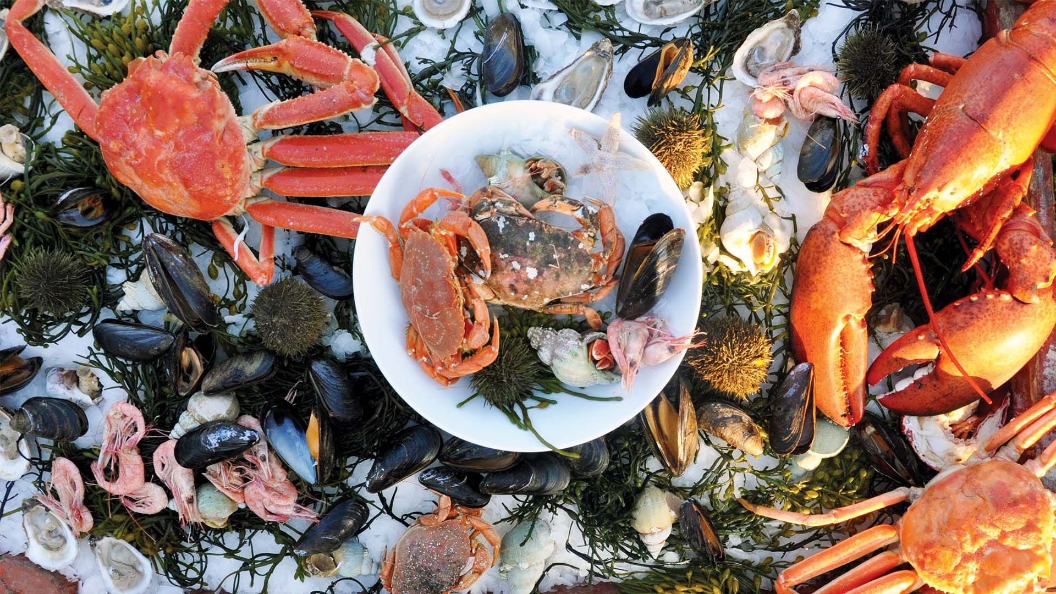
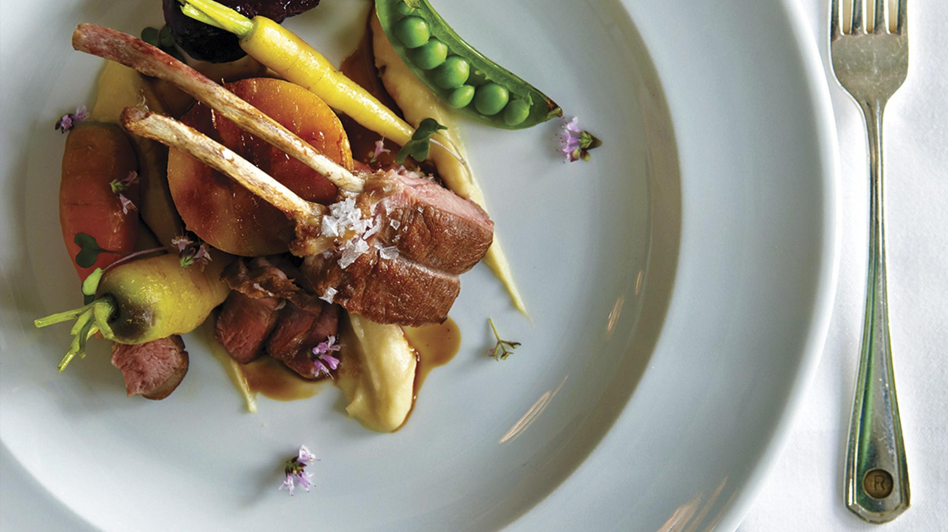
Reasons why foodies will love St . John’s ,Newfoundland & Labrador, Canada.(Mah,2018).
1.Great Gourmet: Explore the capital’s eateries
2. Raise the Bar: drink cocktails in Downtown St. John’s.
3. Festival Fix: Visit during festival season.
4. Best Bolt holes: Go on a food journey beyond the city.
5. Eat like a Local: Make the most of unique dishes
6. Al fresco Eats: Have a picnic on the coast.

Slide 11
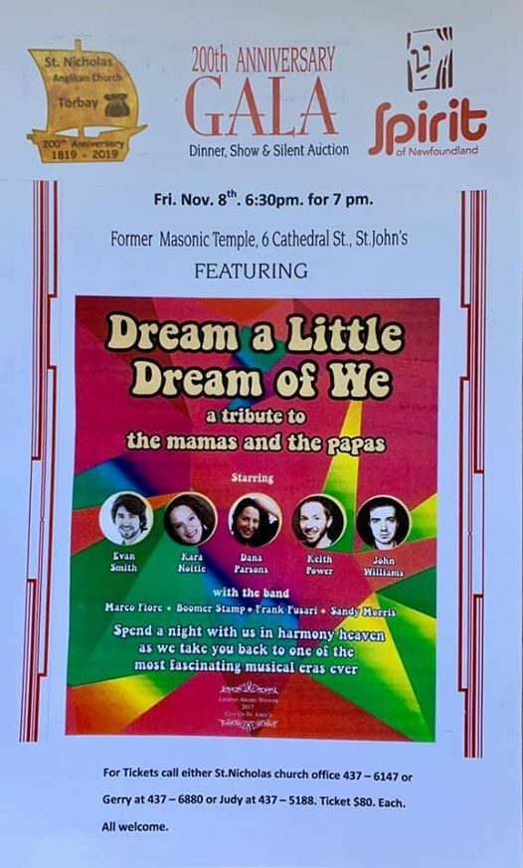
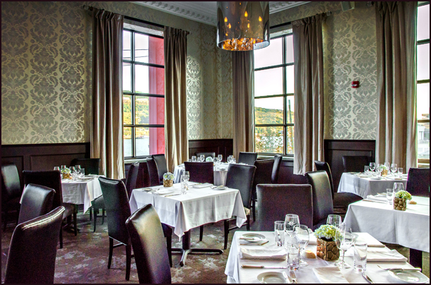
From the rooftop of 95 Water Street, someone is able to see the Narrows, the tall, green and jagged.(Henry,2020)These landmarks which have guarded the harbor to this city for longer than humans have cooked with utensils of wood and rock.

Slide 12
References
Shrimpton, M., & Sharpe, C. (1980). An inner city in decline: St. John's, Newfoundland. Urban History Review/Revue d'histoire urbaine, 9(1), 90-109.
Moore, P. S. (2007). Early Picture Shows at the Fulcrum of Modern and Parochial St. John’s, Newfoundland. Newfoundland and Labrador Studies.
Temple, B., & Gaulton, B. C. (2008). A" Fashionable Tailor" on Water Street: Nineteenth-century Tailor's Chalks from St. John's, Newfoundland. Northeast Historical Archaeology, 37.
Coombs-Thorne, H. (2010). “Mrs. Tilley had a very hasty wedding!”: The Class-Based Response to Marriages in the Grenfell Mission of Newfoundland and Labrador. Canadian Bulletin of Medical History, 27(1), 123-138.
High, S. (Ed.). (2010). Occupied St John's: A Social History of a City at War, 1939-1945. McGill-Queen's Press-MQUP.
Li, X., Que, H., & Power, K. (2017). Welcome to “the rock”: Service providers’ views on newcomer youth integration in Newfoundland and Labrador. Journal of International Migration and Integration, 18(4), 1Butters, L., Hall, H., & Vodden, K. (2019). Mobile Work in Labrador West.105-1122.
Koh, N. P. (1990). Modelling retail system dynamics: an application to the system of major retail centres in the St. John's metropolitan area, 1960-1980 (Doctoral dissertation, Memorial University of Newfoundland).
Mah, C. L., & Taylor, N. (2019). Store patterns of availability and price of food and beverage products across a rural region of Newfoundland and Labrador. Canadian Journal of Public Health, 1-10.
Mah, C. L., Pomeroy, S., Knox, B., Rynard, V., Caravan, M., Burgess, L., ... & Minaker, L. (2018). An assessment of the rural consumer food environment in Newfoundland and Labrador, Canada. Journal of Hunger & Environmental Nutrition.
Henry, W., & Maggie, J. (2020). Tasting Place: Themes in Food and Beverage Product Logos from Three North Atlantic Island Regions. Journal of Gastronomy and Tourism, 4(3), 157-173.

